Slide 1
STRUCTURES AND UNIONS IN C

Slide 2
INTRODUCTION
Arrays allow to define type of variables that can hold several data items of the same kind.
Similarly, structure is another user-defined data type available in C that allows to combine data items of different kinds.
Structures are used to represent a record.
It is used to create compound data structures.
A structure is a convenient way of grouping several pieces of related information together.

Slide 3
A structure is a user defined data type in C/C++. A structure creates a data type that can be used to group items of possibly different types into a single type.
User Defined data types
  typedef
  structures
  Unions
  Enum

Slide 4
INTRODUCTION
Suppose you want to keep track of your books in a library. You might want to track the following attributes about each book:
  Title
  Author
  Subject
  Book ID

Slide 5
Defining a Structure
To define a structure, you must use the struct keyword.
The struct statement defines a new data type, with more than one member. The format of the struct statement is as follows:
struct tag
{
data_type1 member1;
data_type2 member2;
data_type3 member3;
};

Slide 6
Declaring Structure Variables
It is possible to declare variables of a structure, after the structure is defined.
Structure variable declaration is similar to the declaration of variables of any other data types. Structure variables can be declared in following two ways.
  Declaring Structure variables separately
  Declaring Structure Variables with Structure definition
  Declaring multiple structure variables

Slide 7
Declaring Structure variables separately
struct Student
{
char[20] name;
int age;
int rollno;
} ;
struct Student S1 , S2; //declaring variables of Student

Slide 8
Declaring Structure Variables with Structure definition
struct Student
{
char[20] name;
int age;
int rollno;
} S1, S2 ;
Here S1 and S2 are variables of structure Student.

Slide 9
Declaring multiple structure variables
struct Book
{
int pages;
char name[20];
int year;
}book1,book2,book3;

Slide 10
Accessing Structure Members
To access any member of a structure, we use the member access operator (.) dot operator.
struct Book
{
char name[15];
int price;
int pages;
} b1 , b2 ;
b1.price=200;
We can also use scanf() to give values to structure members through terminal.
scanf(" %s ", b1.name);
scanf(" %d ", &b1.price);

Slide 11
Structure Initialization
Like any other data type, structure variable can also be initialized at compile time.
struct Patient
{
float height;
int weight;
int age;
};
struct Patient p1 = { 180.75 , 73, 23 };
struct patient p1;
p1.height = 180.75;
p1.weight = 73;
p1.age = 23;
OR

Slide 12
EXAMPLE
Compound data:
A date is
  an int month and
  an int day and
  an int year
struct ADate {
int month;
int day;
int year;
}date;
date.month = 1;
date.day = 19;
date.year = 2017;

Slide 13
EXAMPLE
Compound data:
A date is
  an int month and
  an int day and
  an int year
struct ADate {
int month;
int day;
int year;
};
struct ADate date;
date.month = 1;
date.day = 19;
date.year = 2017;

Slide 14
initialize structure members?
Structure members cannot be initialized with declaration. For example the following C program fails in compilation.
struct Point { int x = 0; // COMPILER ERROR: cannot initialize members here int y = 0; // COMPILER ERROR: cannot initialize members here };

Slide 15
Evaluate Size of Structure
Sizeof operator is used to evaluate the size of any data type or any variable in c programming.
  With sizeof Operator.(Padding of two bits)
  Without Sizeof Operator

Slide 16
Example with sizeof()
struct stud {
int roll;
char name[10];
int marks;
};
int main() {
int size;
struct stud s;
size = sizeof(s);
printf(“/nSize of Structure : %d", size);
return(0);
}

Slide 17
The sizeof for a struct is not always equal to the sum of sizeof of each individual member. This is because of the padding added by the compiler to avoid alignment issues. Padding is only added when a structure member is followed by a member with a larger size or at the end of the structure.
Example:
#include <stdio.h> int main() { struct A { // sizeof(int) = 4 int x; // Padding of 4 bytes // sizeof(double) = 8 double z; // sizeof(short int) = 2 short int y; // Padding of 6 bytes }; printf("Size of struct: %d", sizeof(struct A)); return 0; }

Slide 18
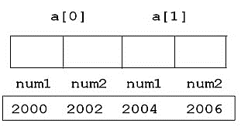
Without Sizeof() Operator
struct {
int num1,num2;
}a[2];
Address of a[0].num1 = 2000
Address of a[0].num2 = 2002
Address of a[1].num1 = 2004
Address of a[1].num2 = 2006
&a[1].num1 – 2004
&a[0].num1 – 2000
Difference Between Them = 2004 – 2000 = 4 Bytes (Size of Structure)

Slide 19
Without Sizeof() Operator
struct {
int num1,num2;
}a[2];
void main()
{
int start , last;
start = &a[1].num1;
last = &a[0].num1;
printf("\nSize of Structure : %d Bytes",start-last);
}

Slide 20
Accessing Structures in Functions
You can pass a structure as a function argument in the same way as you pass any other variable or pointer.
It can be done in below 3 ways.
Passing structure to a function by value
Passing structure to a function by address(reference)
No need to pass a structure – Declare structure variable as global

Slide 21
Accessing Structures in Functions(By Value)
struct Books {
char title[50];
char author[50];
};
strcpy( Book1.author, "Nuha Ali");
printBook( Book1 ); //Function
calling
}
/* function declaration */
void printBook( struct Books book );
int main( ) {
struct Books Book1;
strcpy( Book1.title, "C Programming");
void printBook( struct Books book ) {
printf( "Book title : %s\n", book.title);
printf( "Book author : %s\n", book.author);
}

Slide 22
Accessing Structures in Functions (By Value)
int main()
{
struct student record;
record.id=1;
strcpy(record.name, "Raju");
record.percentage = 86.5;
func(record);
return 0;
}
void func(struct student record)
{
printf(" Id is: %d \n", record.id);
printf(" Name is: %s \n", record.name);
printf(" Percentage is: %f \n", record.percentage);
}
struct student
{
int id;
char name[20];
float percentage;
};
void func(struct student record);

Slide 23
Accessing Structures in Functions (By Reference)
int main()
{
struct student record;
record.id=1;
strcpy(record.name, "Raju");
record.percentage = 86.5;
func(&record);
return 0;
}
void func(struct student *record)
{
printf(" Id is: %d \n", record->id);
printf(" Name is: %s \n", record->name);
printf(" Percentage is: %f \n", record->percentage);
}
struct student
{
int id;
char name[20];
float percentage;
};
void func(struct student record);

Slide 24
Accessing Structures in Functions (By Global)
int main()
{
record.id=1;
strcpy(record.name, "Raju");
record.percentage = 86.5;
structure_demo();
return 0;
}
void structure_demo()
{
printf(" Id is: %d \n", record.id);
printf(" Name is: %s \n", record.name);
printf(" Percentage is: %f \n", record.percentage);
}
struct student
{
int id;
char name[20];
float percentage;
};
struct student record;
// Global declaration of structure
void structure_demo();

Slide 25
Array and Structure in C
We can use structure and array as :
Array of Structure
Array within Structure
Array of Structure | Syntax for declaring structure array
Structure is collection of different data type. An object of structure represents a single record in memory, if we want more than one record of structure type, we have to create an array of structure or object. As we know, an array is a collection of similar type, therefore an array can be of structure type. | struct struct-name { datatype var1; datatype var2; - - - - - - - - - - - - - - - - - - - - datatype varN; }; struct struct-name obj [ size ];

Slide 26
Array of Structures
void main()
{
int i;
for(i=0;i<2;i++) {
scanf("%s",s1[i].c);
scanf("%d",&s1[i].age);
}
for(i=0;i<2;i++) {
printf("%s\n",s1[i].c);
printf("%d\n",s1[i].age);
}
getch();
}
struct student
{
char c[10];
int age;
}s1[2];

Slide 27
#include<stdio.h> struct Employee { int Id; char Name[25]; int Age; long Salary; }; void main() { int i; struct Employee Emp[ 3 ]; //Statement 1 | for(i=0;i<3;i++) { printf("\nEnter details of %d Employee",i+1); printf("\n\tEnter Employee Id : "); scanf("%d",&Emp[i].Id); printf("\n\tEnter Employee Name : "); scanf("%s",&Emp[i].Name); printf("\n\tEnter Employee Age : "); scanf("%d",&Emp[i].Age); printf("\n\tEnter Employee Salary : "); scanf("%ld",&Emp[i].Salary); } printf("\nDetails of Employees"); for(i=0;i<3;i++) printf("\n%d\t%s\t%d\t%ld",Emp[i].Id,Emp[i].Name,Emp[i].Age,Emp[i].Salary); }

Slide 28
Array within Structure
Syntax for array within structure
struct struct-name
{
datatype var1; // normal variable
datatype array [size]; // array variable
- - - - - - - - - -
- - - - - - - - - -
datatype varN;
};
struct struct-name obj;

Slide 29
struct Student { int Roll; char Name[25]; int Marks[3]; //Statement 1 : array of marks int Total; float Avg; }; void main() { int i; struct Student S; printf("\n\nEnter Student Roll : "); scanf("%d",&S.Roll); printf("\n\nEnter Student Name : "); scanf("%s",&S.Name); | S.Total = 0; for(i=0;i<3;i++) { printf("\n\nEnter Marks %d : ",i+1); scanf("%d",&S.Marks[i]); S.Total = S.Total + S.Marks[i]; } S.Avg = S.Total / 3; printf("\nRoll : %d",S.Roll); printf("\nName : %s",S.Name); printf("\nTotal : %d",S.Total); printf("\nAverage : %f",S.Avg); }

Slide 30
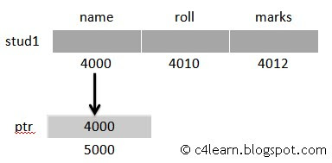
Pointer to Structure
Pointer Variable which stores the address of Structure must be declared as Pointer to Structure .
struct student_database
{
char name[10];
int roll;
int marks;
}stud1;
struct student_database *ptr;
ptr = &stud1;

Slide 31
The address of structure variable can be obtained by using the '&' operator. All structure members inside the structure can be accessed using pointer, by assigning the structure variable address to the pointer.
Syntax
struct structname
{
data type member1;
data type member2;
}variable1, *ptrvariable1; //Pointer to structure declaration

Slide 32
Access using Indirection Operator
struct student_database {
char name[10];
int roll;
int marks;
}stud1 = {”Fahim",90,90};
void main()
{
struct student_database *ptr;
ptr = &stud1;
printf("Roll Number : %d", (*ptr).roll);
printf("Marks of Student : %d", (*ptr).marks);
getch();
}

Slide 33
Access using Membership Operator
void main()
{
struct student_database *ptr;
ptr = &stud1;
printf("Roll Number : %d", ptr→roll);
printf("Marks of Student : %d", ptr→marks);
getch();
}
struct student_database {
char name[10];
int roll;
int marks;
}stud1 = {”Fahim",90,90};

Slide 34
Assigning string value
struct student_database {
char name[10];
int roll;
int marks;
}s;
void main()
{
s.name=“Hello”;
s.marks=500;
printf(“Name : %s", s.name);
printf("Marks of Student : %d", s.marks);
getch();
}
Run Time error: Lvalue Required

Slide 35
Assigning string value
struct student_database {
char name[10];
int roll;
int marks;
}s;
void main()
{
strcpy(s.name,”Hello”);
s.marks=500;
printf(“Name : %s", s.name);
printf("Marks of Student : %d", s.marks);
getch();
}

Slide 36
Nested Structure
Structure written inside another structure is called as nesting of two structures.
Nested Structures are allowed in C Programming Language.
We can write one Structure inside another structure as member of another structure.
  Declare 2 separate structures
  Declare embedded structures

Slide 37
For example
we have two structures named Address and Employee. To make Address nested to Employee, we have to define Address structure before and outside Employee structure and create an object of Address structure inside Employee structure.
Syntax for structure within structure or nested structure
struct structure1
{
- - - - - - - - - -
- - - - - - - - - -
};
struct structure2
{ - - - - - - - - - -
- - - - - - - - - -
struct structure1 obj;
};

Slide 38
Two Separate Structures
struct date
{
int date;
int month;
int year;
};
struct Employee
{
char ename[20];
int ssn;
float salary;
struct date doj;
}emp1;

Slide 39
#include<stdio.h> struct Address { char HouseNo[25]; char City[25]; char PinCode[25]; }; struct Employee { int Id; char Name[25]; float Salary; struct Address Add; }; void main() { int i; struct Employee E; printf("\n\tEnter Employee Id : "); scanf("%d",&E.Id); printf("\n\tEnter Employee Name : "); scanf("%s",&E.Name); | printf("\n\tEnter Employee Salary : "); scanf("%f",&E.Salary); printf("\n\tEnter Employee House No : "); scanf("%s",&E.Add.HouseNo); printf("\n\tEnter Employee City : "); scanf("%s",&E.Add.City); printf("\n\tEnter Employee House No : "); scanf("%s",&E.Add.PinCode); printf("\nDetails of Employees"); printf("\n\tEmployee Id : %d",E.Id); printf("\n\tEmployee Name : %s",E.Name); printf("\n\tEmployee Salary : %f",E.Salary); printf("\n\tEmployee House No : %s",E.Add.HouseNo); printf("\n\tEmployee City : %s",E.Add.City); printf("\n\tEmployee House No : %s",E.Add.PinCode); }

Slide 40
Embedded Structures
struct Employee
{
char ename[20];
int ssn;
float salary;
struct date
{
int date;
int month;
int year;
}doj;
}emp1;

Slide 41
Accessing Nested Elements
Accessing Month Field : emp1.doj.month
Accessing day Field : emp1.doj.day
Accessing year Field : emp1.doj.year

Slide 42
Nested Structure Example
struct Employee
{
char ename[20];
int ssn;
float salary;
struct date
{
int date;
int month;
int year;
}doj;
}emp = {”Fahim",1000,1000.50,{22,6,1990}};
int main()
{
printf("\nEmployee Name : %s",emp.ename);
printf("\nEmployee SSN : %d",emp.ssn);
printf("\nEmployee Salary : %f",emp.salary);
printf("\nEmployee DOJ : %d/%d/%d", emp.doj.date, emp.doj.month, emp.doj.year);
return 0;
}

Slide 43
#include <stdio.h> int main() { struct student { char name[40]; struct avg { int sub1, sub2, sub3; float average; }avg; }stud1, *studptr = &stud1; //Pointer variable stores the address of structure variable | int total; printf("Enter the Name of the student : "); scanf("%s", (*studptr).name); printf("\n------Enter the marks of the student------ "); printf("\nEnter sub1 marks : "); scanf("%d",&studptr->avg.sub1); printf("\nEnter sub2 marks : "); scanf("%d",&studptr->avg.sub2); printf("\nEnter sub3 marks : "); scanf("%d",&studptr->avg.sub3); total = (studptr->avg.sub1 + studptr->avg.sub2 + studptr->avg.sub3); studptr->avg.average = total / 3; | printf("\n-------Student Details-------\n "); printf("Name: %s", studptr->name); printf("\nsub1: %d ", studptr->avg.sub1); printf("\nsub2: %d ", studptr->avg.sub2); printf("\nsub3: %d ", studptr->avg.sub3); printf("\nAverage: %f ", studptr->avg.average); return 0; }

Slide 44
Bit Field/ Bit Manuplation in C
Bit field can be used to reduce memory consumption when it is known that only some bits would be used for a variable. Bit fields allow efficient packaging of data in the memory.
As we know, integer takes two bytes(16-bits) in memory. Some times we need to store value that takes less then 2-bytes. In such cases, there is wastages of memory.
struct { type [member_name] : width ; };

Slide 45
Bit Field in C
struct struct-name
{
datatype var1 : size of bits;
datatype var2 : size of bits;
- - - - - - - - - -
- - - - - - - - - -
datatype varN : size of bits;
};

Slide 46
Bit Field in C Example
struct info1 {
int num;
};
struct info2 {
int num : 1;
};
void main() {
struct info1 f1;
struct info2 f2;
printf("\n\n\tSize of info1 is : %d",sizeof(info1));
printf("\n\n\tSize of info2 is : %d",sizeof(info2));
}

Slide 47
Self Referential Structures
In this Type , Structure has pointer to itself.
Pointer stores the address of the Structure of same type.
struct node
{
int data;
struct node *ptr; //Pointer to Struct node
};

Slide 48
Test Questions
How we can access the structure using pointer?
How we can pass the structure to function?
Show the concept of array of structure and array within structure
Show the concept of malloc() and realloc()

Slide 49
Pictorial Representation
To help us understand and think about self-referential structures, we use pictures:
data
next
The data
members.
The pointer
member.

Slide 50
An Example
struct list {
int data;
struct list *next;
}
struct list a, b, c;
a.data = 1;
b.data = 2;
c.data = 3;
a.next = b.next = c.next = NULL;
a
b
c
1
NULL
2
NULL
3
NULL

Slide 51
Continuation of Example
a.next = &b;
b.next = &c;
a
b
c
1
2
3
NULL
Now we can use the links to retrieve
data from successive elements.
a.next->data = ?
a.next->next->data = ?

Slide 52
Union
A union is a special data type available in C that allows to store different data types in the same memory location.
You can define a union with many members, but only one member can contain a value at any given time.
Unions provide an efficient way of using the same memory location for multiple-purpose.
Unions are conceptually similar to structures. The syntax of union is also similar to that of structure.

Slide 53
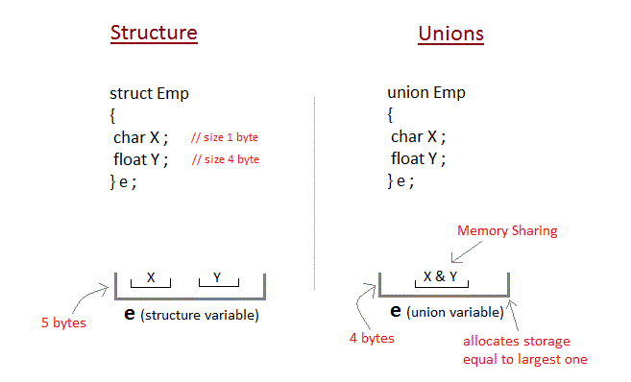


Slide 54
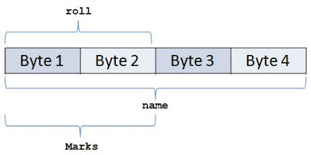
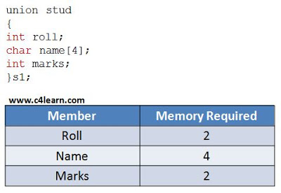
Memory Allocated to Union

Slide 55
Union Example
int main( )
{
union item it;
it.a = 12;
it.b = 20.2;
it.ch='z';
clrscr();
printf("%d\n",it.a);
printf("%f\n",it.b);
printf("%c\n",it.ch);
getch();
}
union item
{
int a;
float b;
char ch;
};

